Slide 1
Microsoft Visual Studio 2010
Web.Config Transformations
Jay W. Smith PMO Architect
Tyson Foods, Inc.

Slide 2
We are here today to…
Gaze into the future of web deployment
Package web applications
Prepare your web.config files for prime time
Share web apps with peers and community
Enable continuous integration for web applications
Get a sneak peek at what’s cooking for DB Deployment

Slide 3















Web Deployment Story - Today
Copy Web
Publish Web
Web Application
Dev Box
Server

Slide 4
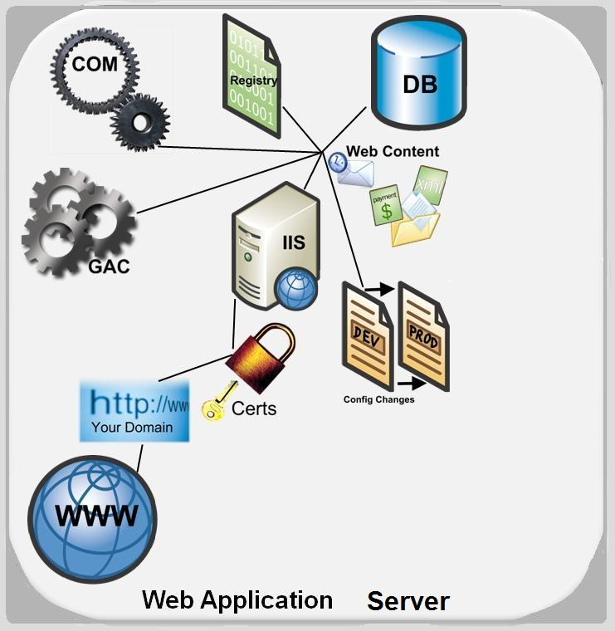
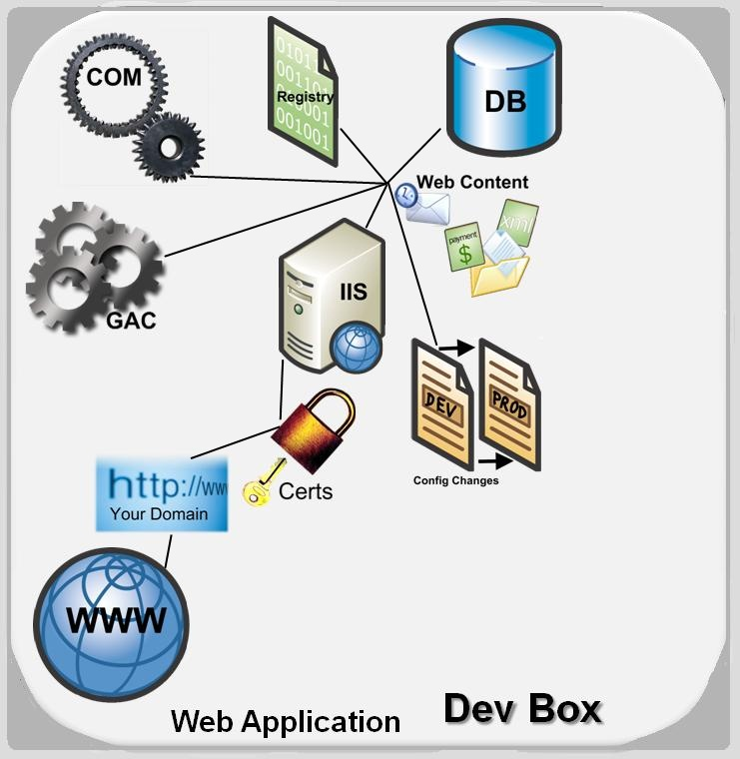





Web Deployment w/ VS10
Dev Environment
Server Environment
MS DEPLOY

Slide 5
1-Click Web Deployment
demo
On VS10 Oct 25th Build

Slide 6









Data Flow Diagram
Dev Box
Remote Server
Pckg Install Command
Pckg Install Command
Local Server

Slide 7
Web Packaging
demo
On VS2008 PDC-CTP Build

Slide 8
Web Publishing Pipeline (WPP)
Collection
Collects Required Files for packaging/publishing
Transformation
Changes your app to make it server ready
Output
Outputs your web to desired location e.g. FTP, File System, MSDeploy

Slide 9
Web Publishing Pipeline (WPP)
Build
Collection:
O/P Binaries + PDBs
Collection:
References
Collection:
Content
Transformation:
Merge
Transformation:
Pre-Compile
Transformation:
Exclude Files
Transformation: Web.Config
Output:
FTP, FS, MSDeploy, HTTP
MSDeploy:
GAC, COM, Registry
MSDeploy:
IIS Settings, Certificates
MSDeploy:
DB (Data, Schema, Scripts)
MSDeploy:
Publish
MSDeploy:
Package
MSDeploy:
Create Manifest

Slide 10
Web Publishing Pipeline
demo
On VS2008 PDC-CTP Build

Slide 11
Web.Config Transformations

Slide 12
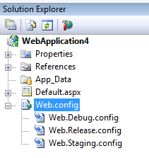
Asks…
Don’t Duplicate Web.Config
(If I don’t want to ☺)
Honor Build Configurations
Make it Extensible
Make it Customizable
Make it Simple
Make it Powerful

Slide 13



Web Config Transformation
XML Transformation Engine
(Staging Ready)
Outputted to OBJ\staging folder of your project
Web.Staging.Config

Slide 14



Transformation Concepts
XML Transformation Engine
Web.Staging.Config
(Staging Ready)

Slide 15
Web.Config Transformation
demo
On VS2008 PDC-CTP Build

Slide 16
Why not XSLT?
<?xml version="1.0" ?>
<xsl:stylesheet xmlns:xsl="http://www.w3.org/1999/XSL/Transform" version="1.0">
<xsl:template match="@*|node()">
<xsl:copy>
<xsl:apply-templates select="@*|node()"/>
</xsl:copy>
</xsl:template>
<xsl:template match="/configuration/appSettings">
<xsl:copy>
<xsl:apply-templates select="node()|@*"/>
<xsl:element name="add">
<xsl:attribute name="key">NewSetting</xsl:attribute>
<xsl:attribute name="value">New Setting Value</xsl:attribute>
</xsl:element>
</xsl:copy>
</xsl:template>
</xsl:stylesheet>
<configuration xmlns:xdt=”http://schemas.microsoft.com/XML-Document-Transform”>
<appSettings> <add name=”NewSetting” value=”New Setting Value” xdt:Transform=”Insert”/>
</appSettings>
</configuration>

Slide 17
Web.Config Transformation Recap
Transform | Description
xdt:Transform=“Replace” | Replaces the first matched node
xdt:Transform=“Remove” | Removes the first matched node
xdt:Transform=“RemoveAll” | Removes all the matching nodes
xdt:Transform=“Insert” | Inserts the node at the end
xdt:Transform=“SetAttributes(attributeNames)” | Creates or changes values of the existing attributes
xdt:Transform=“RemoveAttributes(attributeNames)” | Removes the attributes if they exist
xdt:Transform=“InsertBefore(XPath)” | Inserts the node on the provided Xpath
xdt:Transform=“InsertAfter(XPath)” | Inserts the node on the provided XPath

Slide 18
Web.Config Transformation Recap
Locator | Description
xdt:Locator=“Match(attributeName)” | Can accept comma seperated names of the attributes
Xdt:Locator=“Condition(xPath Predicate)” | Can take any Xpath predicates like xdt:Locator="Condition(@name=’Northwind or @providerName=’ System.Data.SqlClient’)"
Xdt:Locator=“Xpath(/configuration/…)” | Can take any complicated Xpath like "XPath(//system.web)"

Slide 19
DB Deployment Sneak Peek
demo
On VS2008 Oct 25th 2008 Build

Slide 20
Related Content
TL48 - Microsoft Visual Studio: Web Development Futures [Monday]
PC20 - ASP.NET 4.0 Roadmap [Monday]
ES14 - Microsoft Internet Information Services 7.0 and Beyond [Wednesday]
ES15 - Deploying Web Applications with Microsoft Internet Information Services 7.0 and the Web Deployment Tool [Wednesday]

Slide 21
Resources
http://vishaljoshi.blogspot.com/
http://blogs.msdn.com/webdevtools/
http://www.asp.net

Slide 22



Evals & Recordings
Please fill out your evaluation for this session at:
This session will be available as a recording at:
www.microsoftpdc.com

Slide 23
Please use the microphones provided
Q&A

Slide 24

© 2008 Microsoft Corporation. All rights reserved. Microsoft, Windows, Windows Vista and other product names are or may be registered trademarks and/or trademarks in the U.S. and/or other countries.
The information herein is for informational purposes only and represents the current view of Microsoft Corporation as of the date of this presentation. Because Microsoft must respond to changing market conditions, it should not be interpreted to be a commitment on the part of Microsoft, and Microsoft cannot guarantee the accuracy of any information provided after the date of this presentation. MICROSOFT MAKES NO WARRANTIES, EXPRESS, IMPLIED OR STATUTORY, AS TO THE INFORMATION IN THIS PRESENTATION.

